Slide 1

SPOTIFY CLONE
KONDAKA JYOTHI

Slide 2
Contents
Abstract
Introduction
Literature Survey
Problem Definition
Proposed system
Architecture of Proposed System
Project features
Code picture
Html implementation
Html code
Css implementation
Conclusion
1
Notes:
*
BATCH No:
2

Slide 3
Abstract
This project focuses on developing a Spotify Clone—a web-based music streaming platform that replicates the core features of Spotify. The system allows users to stream audio content, create and manage playlists, search for songs, and explore music by artists, genres, and albums. Built using modern web development technologies such as HTML, CSS, JavaScript (React), and backend tools like Node.js and MongoDB (or Firebase), the platform ensures a user-friendly interface and smooth playback experience. The clone also demonstrates features like user authentication, responsive design, and real-time song control. This project aims to understand the architectural, UI/UX, and technical aspects of building a scalable media streaming application.

Slide 4
Introduction
With the growing demand for online music streaming, platforms like Spotify have revolutionized the way users consume audio content. Inspired by its success, this project involves the development of a Spotify Clone—an application that mimics the essential functionalities of Spotify, including music playback, playlist management, browsing, and searching songs
This clone serves as a learning project to understand full-stack web development, API integration, real-time media handling, and user authentication. Technologies such as HTML, CSS, JavaScript (React.js), Node.js, Express, and a database like MongoDB or Firebase are used to build this system. By replicating key Spotify features, the project not only enhances practical skills but also demonstrates how large-scale streaming platforms operate behind the scenes.

Slide 5
Literature Survey
S. No. | Title / Study | Authors / Year | Methodology / Approach | Key Findings | Limitations
1 | Building a Music Streaming App using React | R. Kumar / 2023 | Used MongoDB, Express.js, React.js, Node.js; JWT for authentication | Achieved full-stack music streaming app with playlist and user login support | No real-time audio streaming; basic security features only
2 | Clone of Spotify using React and Spotify API | M. Singh / 2024 | Used Spotify Developer API for music content and React for UI rendering | Enabled real music search, playback using Spotify's API; real-world data use | Dependent on third-party APIs; no control over audio content or customization
3 | Full Stack Audio Streaming Platform | K. Jyothi / 2025 | Custom full-stack development using React, Node.js, MongoDB | Custom-built Spotify-like experience with user login, playlists, and music UI | No integration of recommendation or AI-based features

Slide 6
Problem Definition
In today's digital era, music streaming has become the primary mode of audio consumption. However, existing platforms like Spotify, while feature-rich, come with certain limitations such as restricted access without premium subscriptions, lack of source code transparency, and limited customization for educational or development purposes. These constraints make it difficult for learners and developers to understand the underlying architecture and functionality of such complex systems.
To address these issues, this project aims to develop a Spotify Clone—a simplified yet functional music streaming web application that replicates the core features of Spotify. The goal is to provide an open, customizable platform for learning full-stack web development, user interface design, media playback handling, and database integration. This project will serve as both a learning tool and a demonstration of how music streaming platforms work on a technical level.

Slide 7
Proposed System
The proposed system is a Spotify Clone, a web-based music streaming application designed to replicate the core features of Spotify while offering a simplified and customizable environment for learning and development. This system will allow users to stream songs, create and manage playlists, search for music by title or artist, and enjoy a responsive user interface.
This system aims to provide:
A user-friendly music player with basic playback controls
A login/signup system for personalized access
Playlist creation and management
Search functionality for music discovery
A scalable architecture to demonstrate full-stack development skills

Slide 8
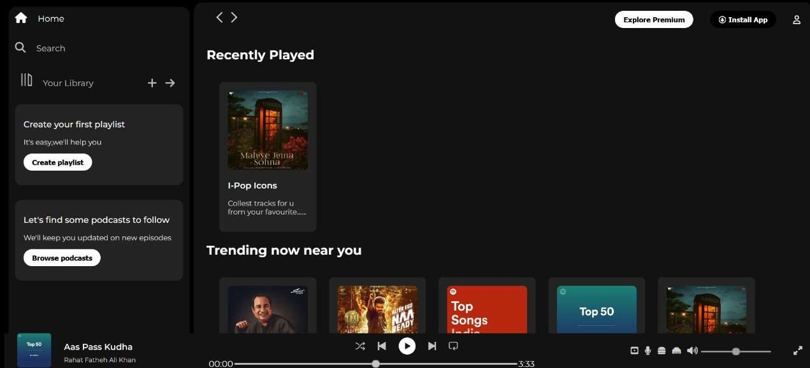
Architecture of proposed System

Slide 9
Project Features
1.Homepage:A visually engaging page with a header, navigation bar, and a grid layout
showcasing playlists, albums, or songs.
2.Player Page:A dedicated page that mimics a music player interface with a play/pause
button,volume control,and song progress bar.
3.ResponsiveDesign:Ensures compatibility across various screen sizes using CSS
techniques like media queries.
4.Static Content: The app does not include backend functionality but uses placeholder
content for songs and playlists

Slide 10
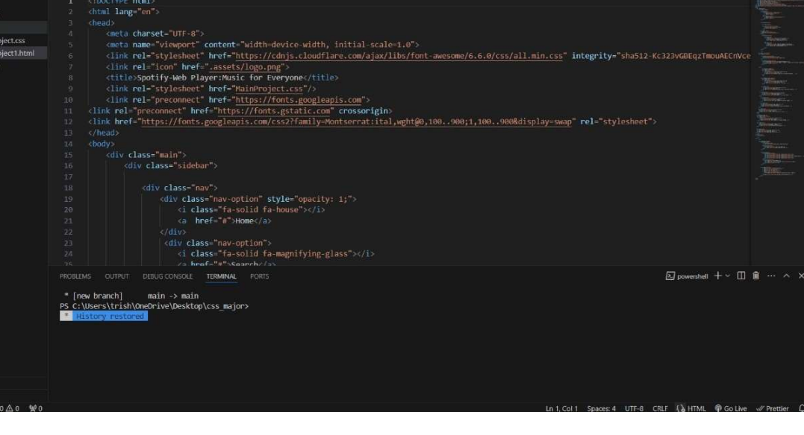
Code Picture

Slide 11
HTML Implementation
HTML (HyperText Markup Language) is used to structure the content of the app. Key HTML
features utilized include:
-Semantic Elements: Elements such as <header>,<nav>,<main>,<section>, and <footer> are used for
better structure and readability.
- Div-Based Layouts: <div>elements are employed to group and organize content effectively.
-Lists: <ul>and <li>elements are used for creating the navigation bar and playlist items, ensuring a
structured layout.
-Media Elements: The <img>tag is used to display album art or icons, and <audio> can be incorporated
for a functional music player if extended further.
-Links and Buttons: <a>and <button> elements provide navigation and interaction features, such as
switching between pages and simulating playback controls.
-Forms and Inputs: Basic forms with <input> elements can be used to simulate a search bar for finding
songs or playlists

Slide 12
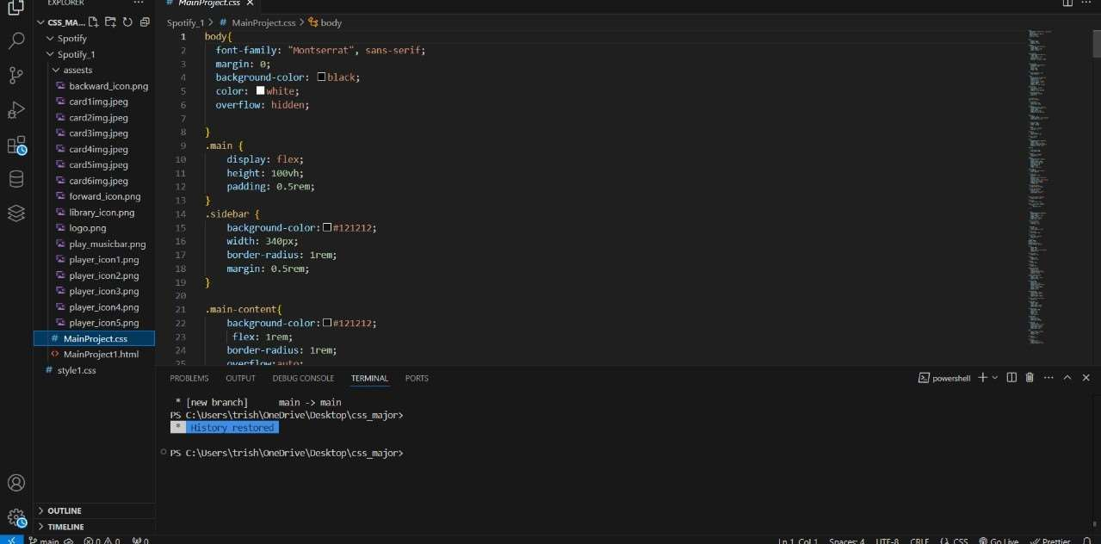
CODE

Slide 13
Css Implementation
CSS (Cascading Style Sheets) plays a crucial role in this mini-project to design the app with a clean, modern, and
responsive interface. The following techniques and concepts are used to ensure the app looks good on any device while
offering an intuitive and user-friendly experience:
1.Box Model:
The CSS Box Model is fundamental for designing layouts. It includes margins, borders, padding, and the actual content area.
Understanding how to apply and manipulate the box model helps control the spacing between elements and create visually
structured layouts.Margins provide space outside an element.Padding gives space inside an element.Borders define the
edges of an element.
2. Flexbox Layout
Flexbox is a powerful layout model that allows for responsive and efficient layouts. It provides an easy way to align items in
rows or columns and distribute space dynamically.Flexbox properties like justify-content, align-items, and flex-wrap allow
the creation of flexible and scalable designs.Flex Containers define how items will be arranged inside the container.
3.Hover Effects and Transitions
To add interactivity and enhance the user experience, hover effects and smooth transitions can be used. When the user
interacts with elements like buttons or playlist items, CSS transitions help create a smooth visual effect.
4. Custom Fonts and Colors
Typography and color schemes are essential in web design for setting the mood and readability of the site. Custom fonts
and colors help in creating a modern and appealing look.

Slide 14
Conclusion
The Spotify Clone project successfully replicates the core functionalities of a modern music streaming platform, providing features such as user authentication, music playback, playlist management, and search functionality. It demonstrates the effective use of full-stack technologies like React.js, Node.js, and MongoDB/Firebase. Through this project, we gained practical experience in building scalable, responsive web applications and understood the technical architecture behind real-world streaming services. This clone serves as a strong foundation for further enhancement, such as adding AI-based recommendations, real-time streaming, or mobile app integration

Slide 15
THANK YOU

